Slide 1
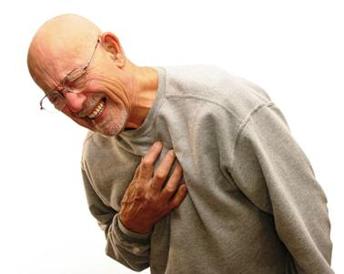
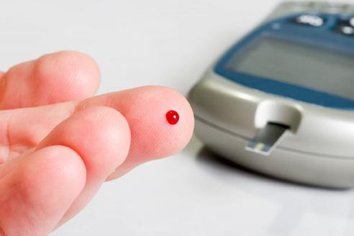
How does obesity lead to disease?
Metabolic Diseases Lesson 3.6

Slide 2
Do Now
What diseases do you know to be associated with obesity?

Slide 3
Diseases associated with obesity
System | Examples of comorbidity
Cardiovascular | Atherosclerosis; Coronary heart disease; Hypertension; Congestive heart failure; Peripheral artery disease
Pulmonary | Sleep apnea; Asthma; Pulmonary embolus
Immune | Reduced immune response
Endocrine | Type 2 diabetes; Dyslipidemia
Gastrointestinal | Gastroesophageal reflux; Fatty liver disease
Musculoskeletal | Osteoarthritis; Back pain; Gout
Cancer | Breast; Prostate; Colon
Neurological | Macular degeneration; Depression
Psychosocial | Discrimination; Quality of life; Absenteeism
Notes:
Students may recognize this table from Lesson 3.1. We are going to spend the rest of the time discussing atherosclerosis and type 2 diabetes because these are common, life-threatening diseases.

Slide 4
Activity
Work in groups to read and answer the questions on your worksheet about type 2 diabetes and atherosclerosis.

Slide 5
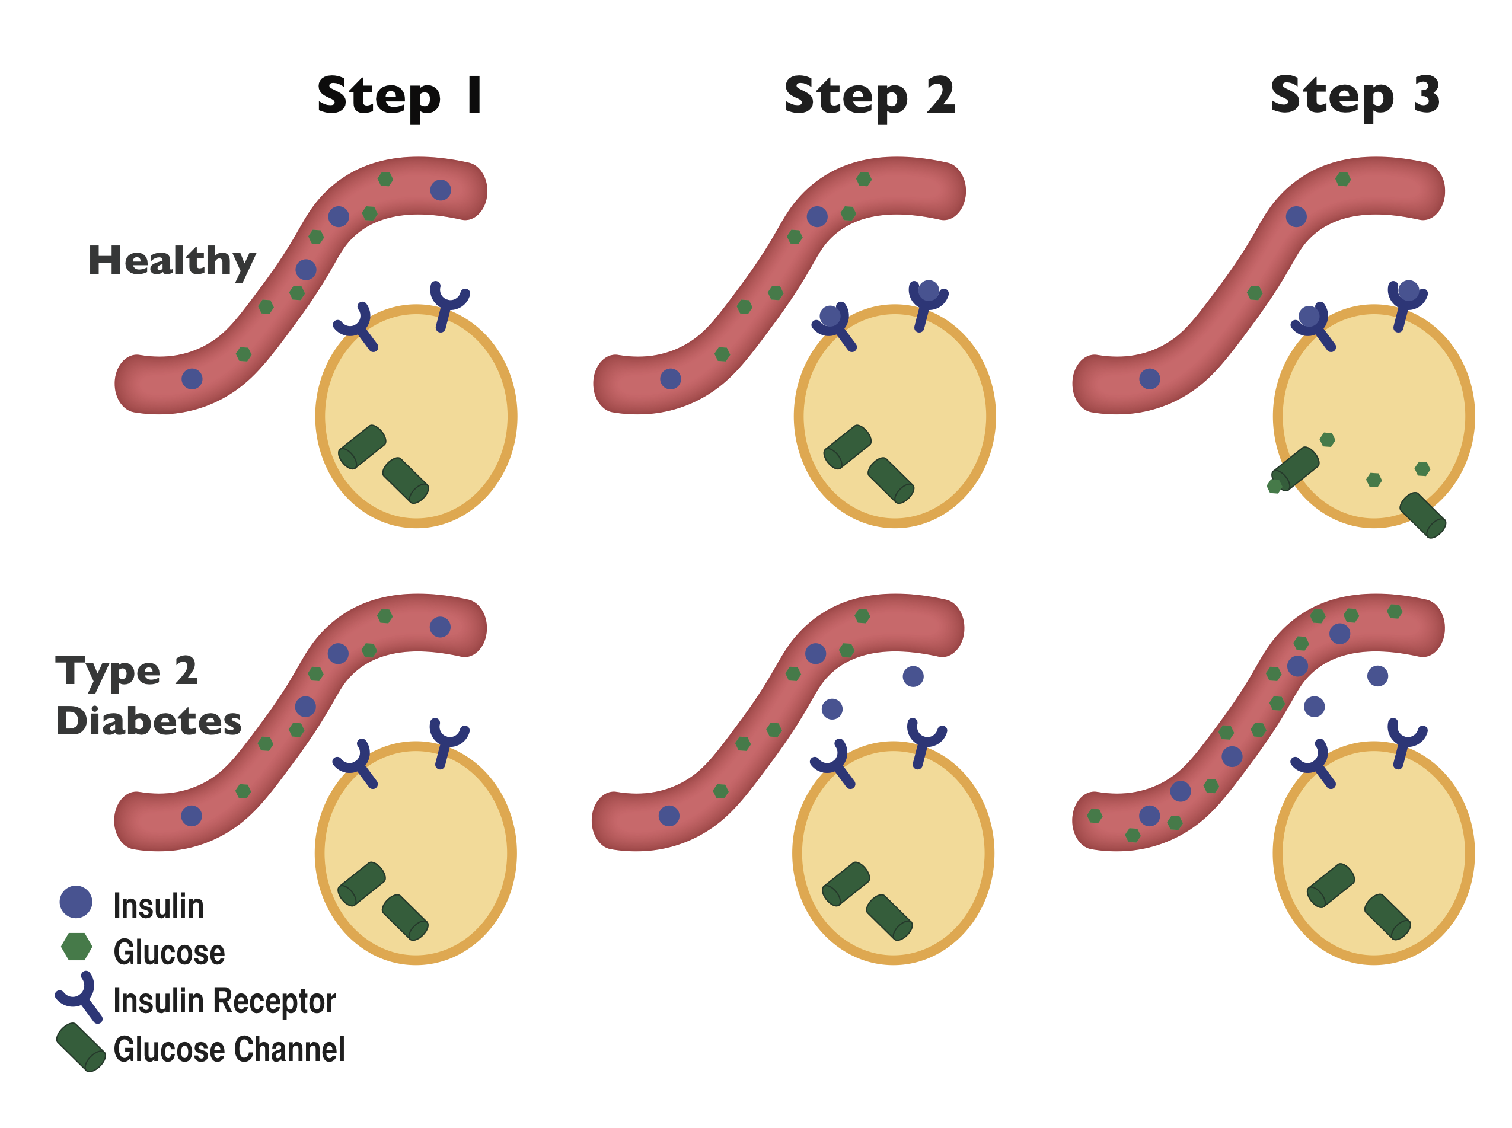
Type 2 Diabetes

Slide 6
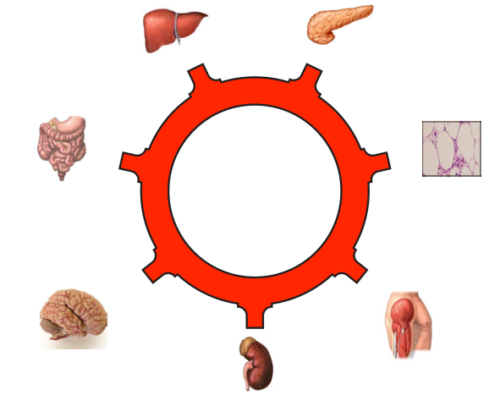
What happens after eating in the liver, muscles and adipose in someone with type 2 diabetes?
Where do these extra fatty acids go?

Slide 7
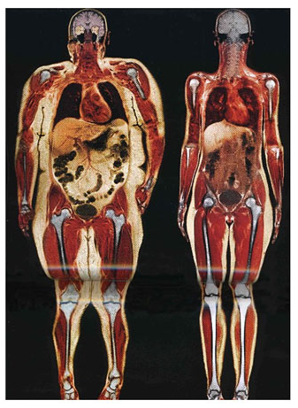
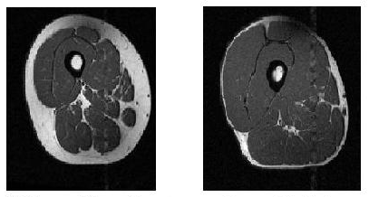
Extra fat in blood leads to fat gathering outside of the adipose

Slide 8
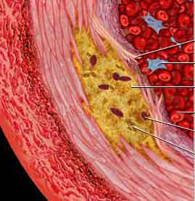
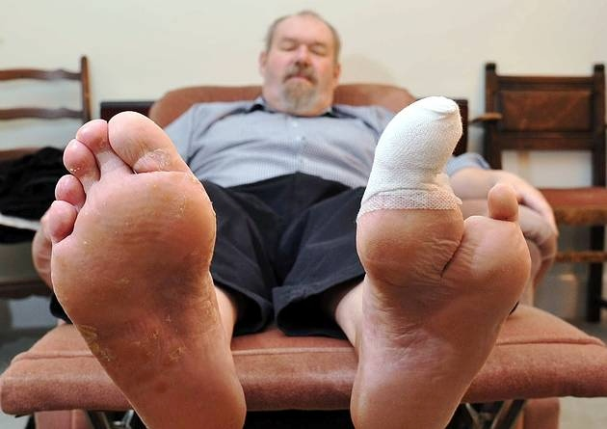
What are the health consequences of type II diabetes?
Loss of Vision
Atherosclerosis
Amputations
Notes:
Damaged blood vessels may lead to:
Cardiovascular disease
Atherosclerosis, stroke
Dying off of nerves
Loss of sensation, making it hard to know if wound occurs. Can lead to amputations if wound isn’t treated
Blindness
Decreased ability to heal wounds
Ask students how type II diabetes would lead to these consequences: High blood pressure is caused by extra glucose in blood increasing the osmolality (water from the cells will leak into blood vessels to even out the high concentration of glucose). Cardiovascular Diseases, like peripheral or stroke are caused by damage done to the blood vessels by the high blood glucose – we will learn more about this process next!
Nerve damage in diabetics is caused by damage to tiny blood capillaries that supply the nerves with oxygen and nutrients. The nerves die away, resulting in loss of feeling or blindness. This can lead to amputations.
Reduced immune function is caused by lowered white blood cells and a reduction of oxygen and nutrients to the site of a wound, resulting in a longer time it takes to heal.

Slide 9
What is Atherosclerosis?
Build up of fatty streaks in blood vessels, causing them to harden
Very prevalent:
Nearly everyone in the developed world has atherosclerosis before they turn 20!
Notes:
Discuss that not everyone will have a plaque rupture. It depends on the size of the plaque and the thickness of the artery wall.

Slide 10
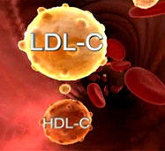
What causes atherosclerosis?

Slide 11
Atherosclerosis
LDL sticks to damaged wall of blood vessel
Immune cells arrive to damaged site, infiltrate into the vessel wall
Immune cells “eat” LDL and become trapped in vessel wall
Plaque

Slide 12
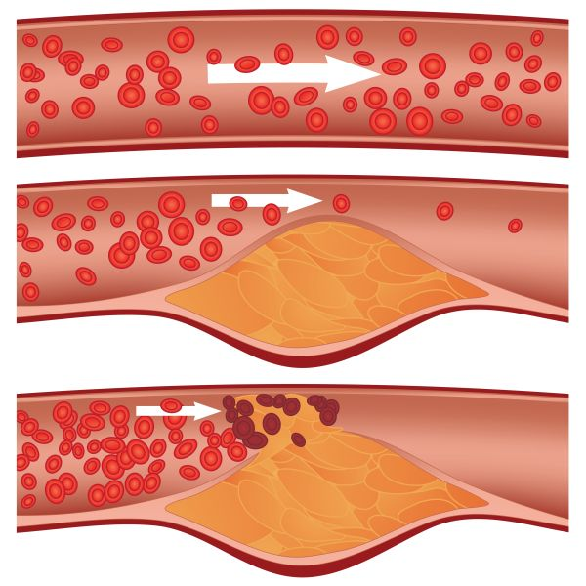
The plaque can harm us in three ways:
Increasing blood pressure
Reducing blood flow
The plaque can rupture, causing a blood clot. The clot can get stuck:
In the lungs – Pulmonary Embolism
In the heart – Heart attack
In the brain – Stroke

Slide 13
Why doesn’t everyone that is obese get type 2 diabetes or atherosclerosis? And why do people with healthy weights and cholesterol still get these diseases?

Slide 14
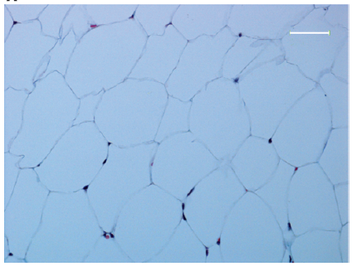
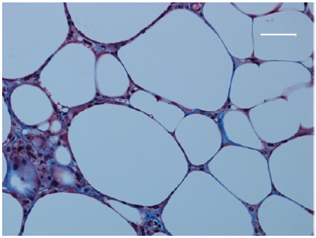
“Healthy” and “Unhealthy” Adipose Tissue may be the key
“Healthy” Adipose
“Healthy” Adipose
After Weight Gain
“Unhealthy” Adipose After Weight Gain

Slide 15
Wrap Up
How can diet and exercise help to prevent or reduce the risk of type 2 diabetes and atherosclerosis?

Slide 16
Homework
Review and correct your answers on the Lesson 3.6 Worksheet

